Slide 1
Tools & Techniques of game development
Muhammad Salman

Slide 2
My Introduction
BS Software Engineering
Batch 2017-21
Graduated From University of South Asia
Junior Game Developer At “The Game Storm Studios”

Slide 3
Table Of Content
Team Members in Gaming Industry
Import Websites for 3dmodels and Environment
Important Controllers
How we Earn From App
How to publish our App
Free Controller/ Game
Conclusion
Question Answers

Slide 4
Team Members
Developer
Game UI Designer
CG Artist(Post Screen-Shot Designer)
3d Models Designer
ASO Marketer
Q.A

Slide 5
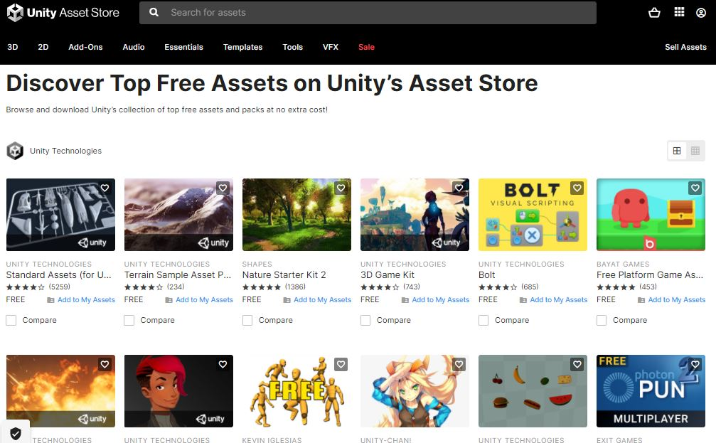
Important Website's
Unity Asset Store
https://assetstore.unity.com/
https://assetstore.unity.com/top-assets/top-free

Slide 6
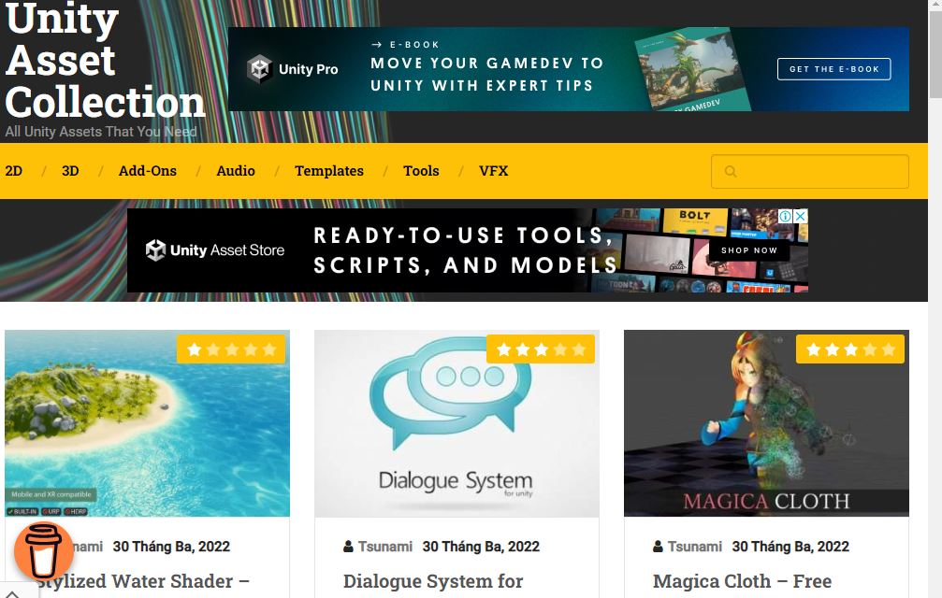
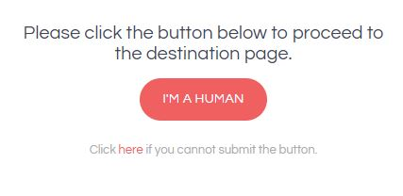
Important Websites
Unity Asset Collection
https://unityassetcollection.com/
Zen mate Mate , Betternet VPN

Slide 7
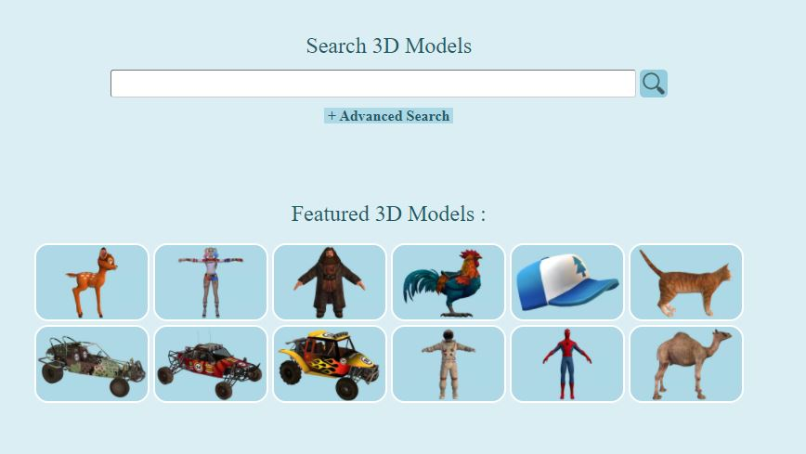
Important Website's
3d Models Free Download
https://rigmodels.com/

Slide 8
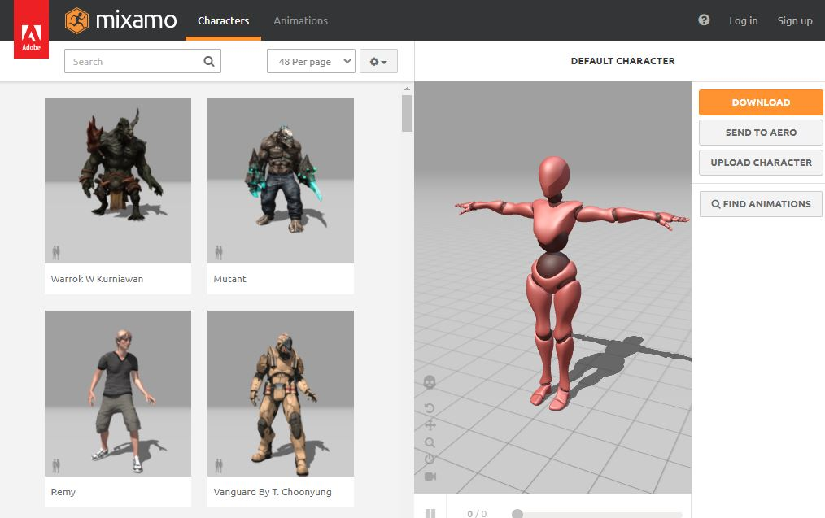
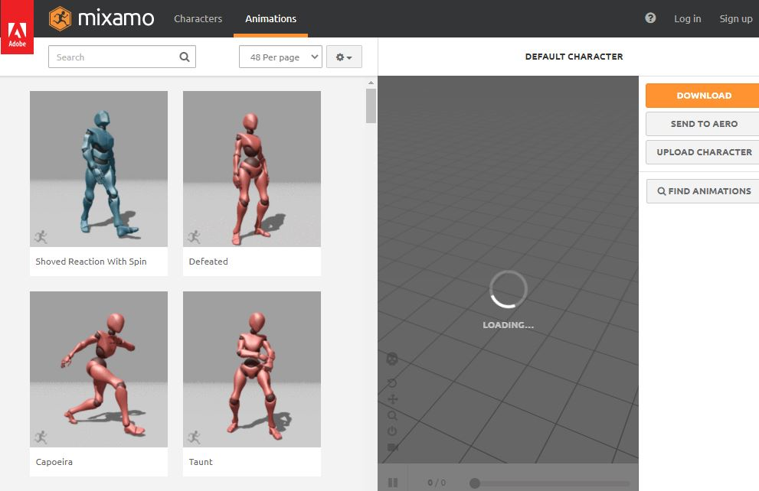
Important Website's
Mixamo For Animation and character
https://www.mixamo.com/

Slide 9
Important Controllers
For Car Controller
RCC(Realistic Car Controller)
For Shooting
RFPS , FPS, UFPS
Bike Controller (Side View Controller, Simple)

Slide 10
How To Earn From App
Monetization (ADS)
INApp Purchases
Platform
Admob
Unity Ads
IronSource
Consoli Ads
Applovin
Adcolony

Slide 11
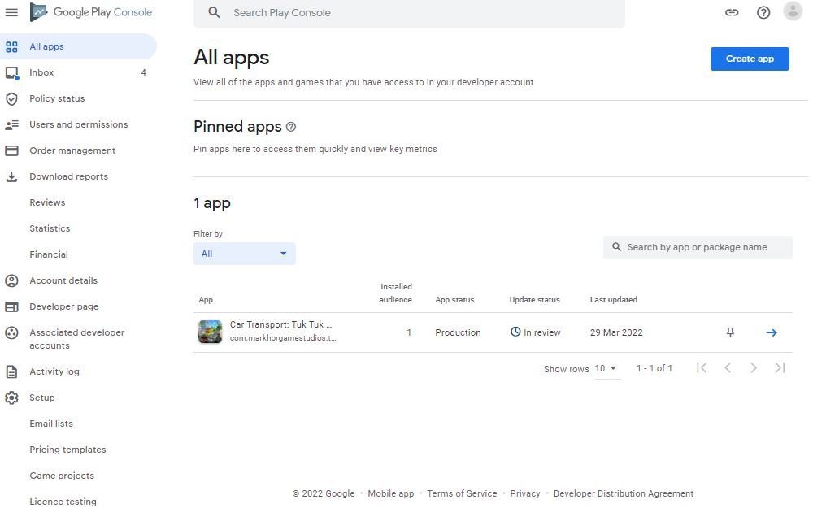
How to publish our App
For Android you need Play Store Console (Cost 25$ one time)
For IOS you need IOS Console (25,000 PKR per Year)
Other Store Also Available
Galaxy Store , Amazon Store

Slide 12
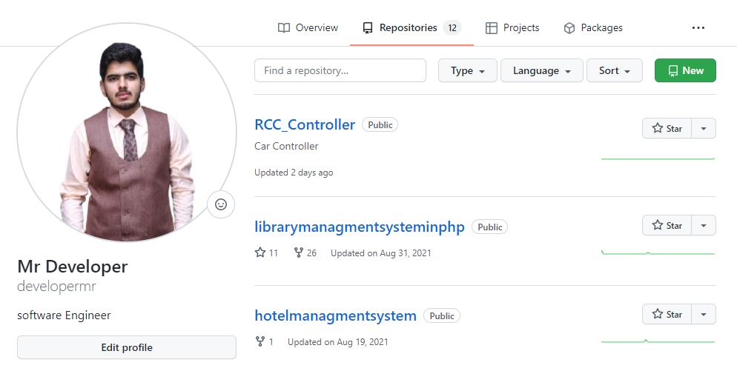
Free Controller
https://drive.google.com/file/d/1myFel74HRgPvmG6gvcAfUVSA3xb1u97h/view?usp=sharing

Slide 13
Game Development Course
https://markhorgamestudios.com/
markhorgamestudios@gmail.com
1Month Duration
Contact For Fees
Controllers Provided
Games Provided
Google Console Account Provided

Slide 14
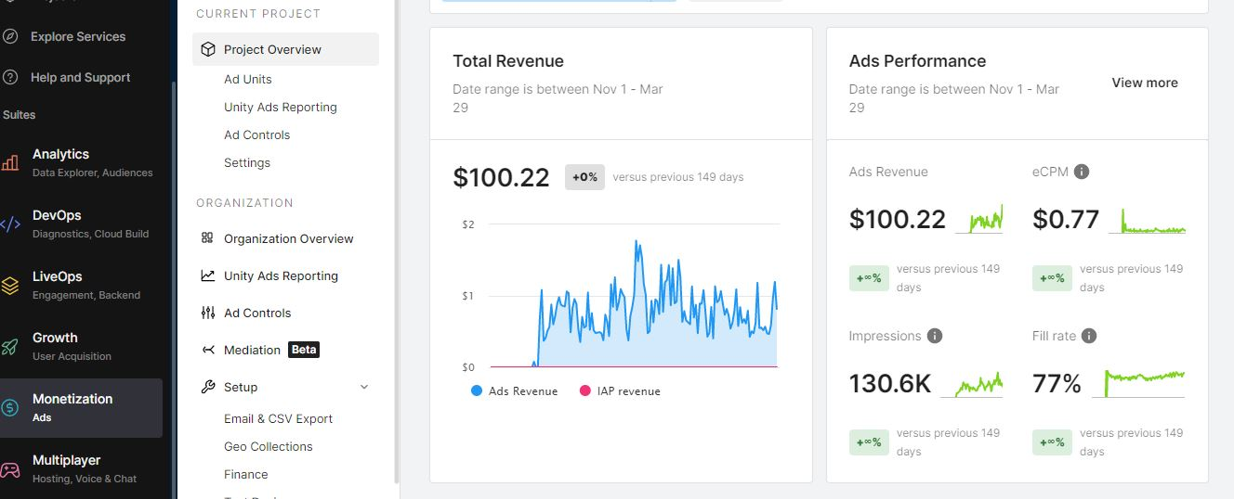
For Motivation

Slide 15
(The Teacher is not a king himself, But he makes kings)
THANKS
ANY QUESTION?

